Slide 1
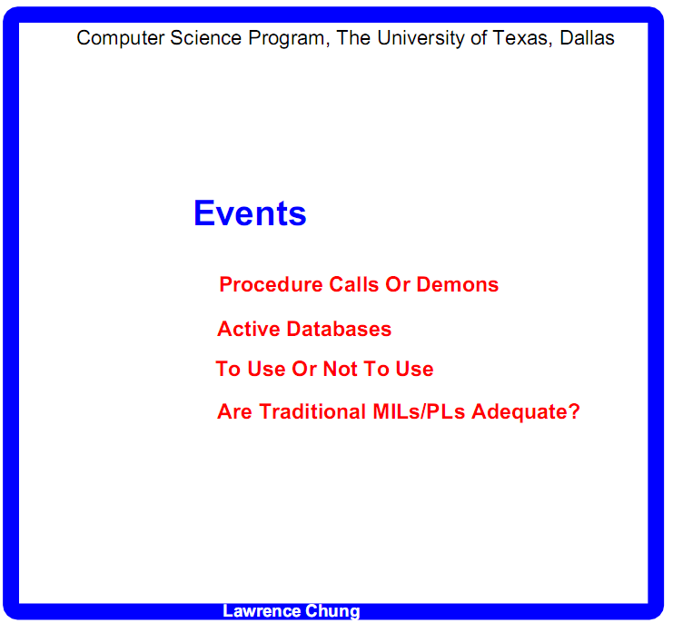

Slide 2
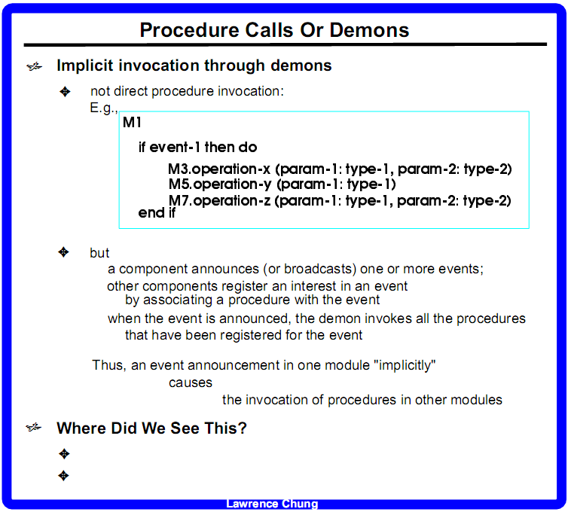

Slide 3
I
You
Announcer/publisher/subject
Listener/subscriber/observer
candy
candy
announce
register
de-register
Control/demon

Slide 4
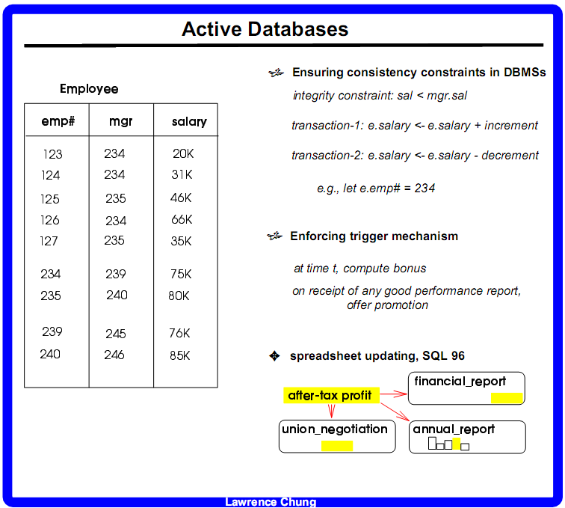
Passive d ~ slave-master
sal <= mgr.sal
Tx1
Tx2
Tx3
…
tx100
e.sal < e.mgr.sal
75k 85K
75k -> 15k
DDL:
Table Employee
fields/attributes
emp#
mgr
salary
Integirty constraint
sal < mgr.sal
exc-handler Tx-handle-sal-…
DML: SQL (PL-SQL)
…
245 0 90K

Slide 5
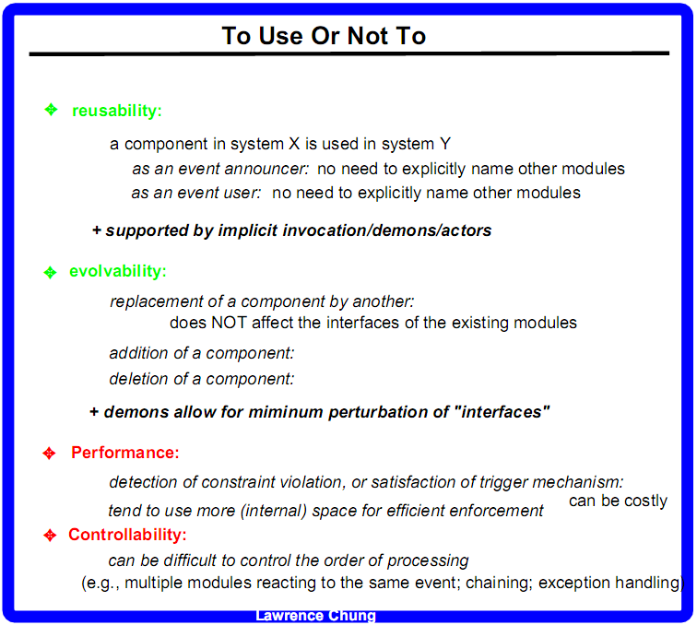

Slide 6
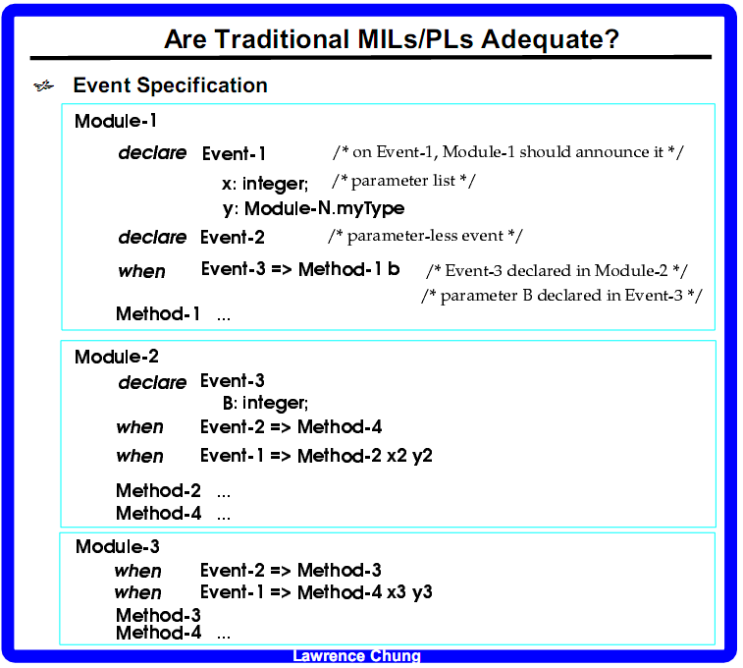

Slide 7
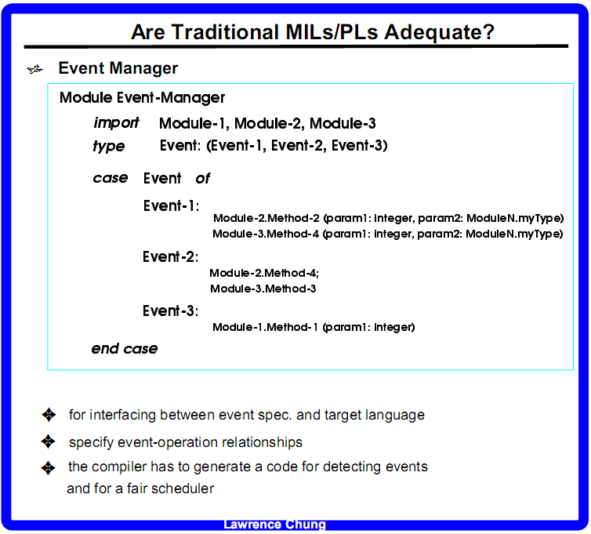

Slide 8
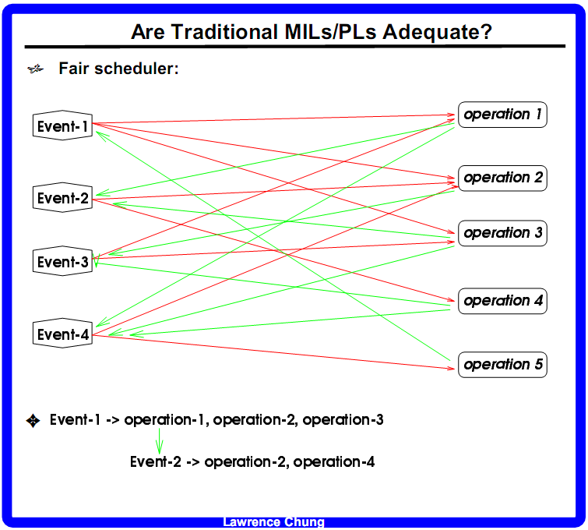

Slide 9
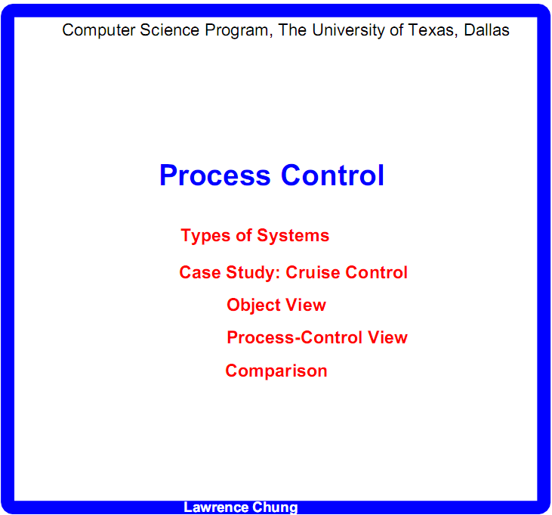

Slide 10
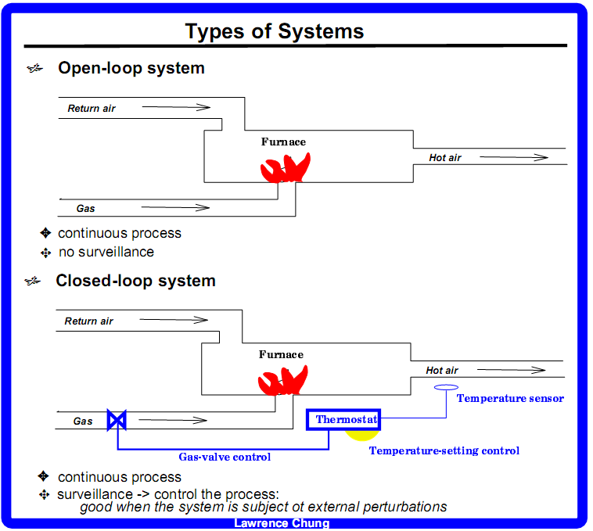

Slide 11
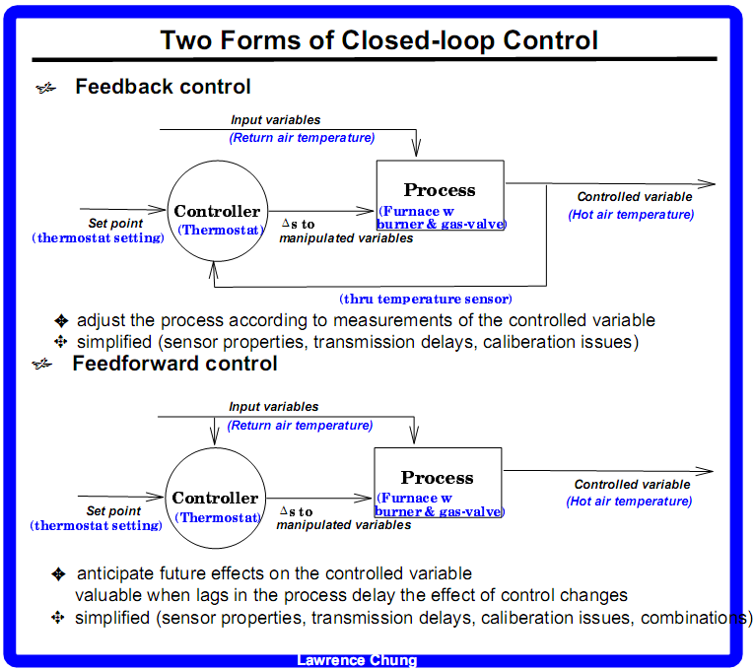

Slide 12
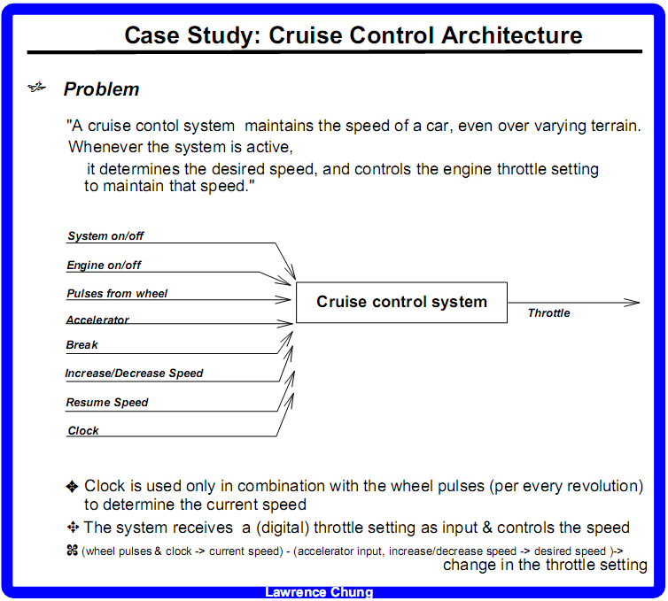

Slide 13
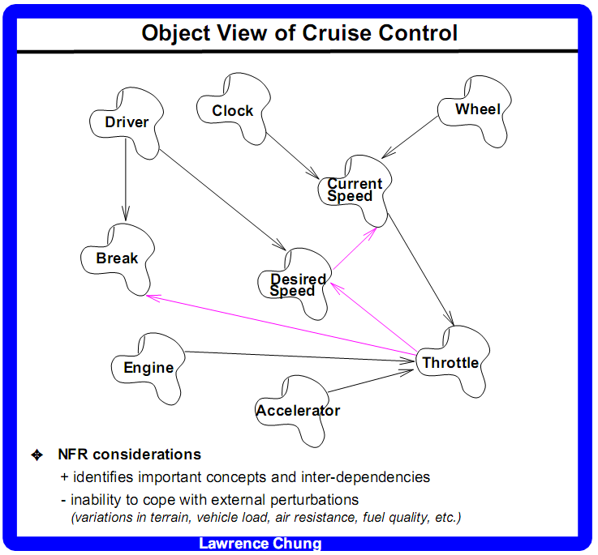

Slide 14
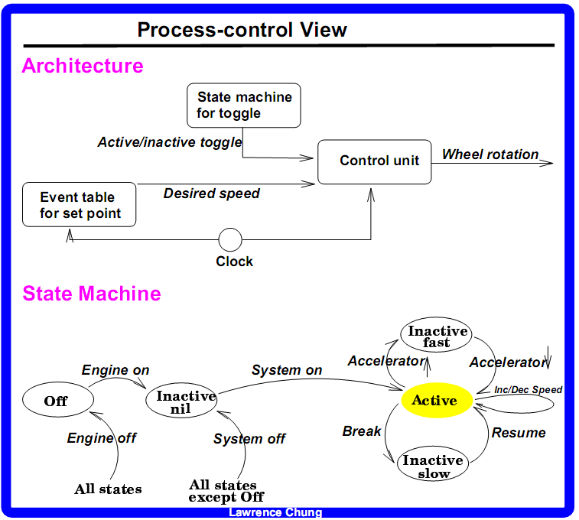

Slide 15
